Slide 1
MHA Report Findings: The Urgent Need for More Education, Services, and
Supports
Mary Giliberti, Sydney Daniello, & Ethan Burrell

Slide 2
Who is this Information for?
The Target Audience for this Resource Includes:
State policymakers
Advocates
Youth
Families
Administrators
Mental Health Professionals
Educators

Slide 3
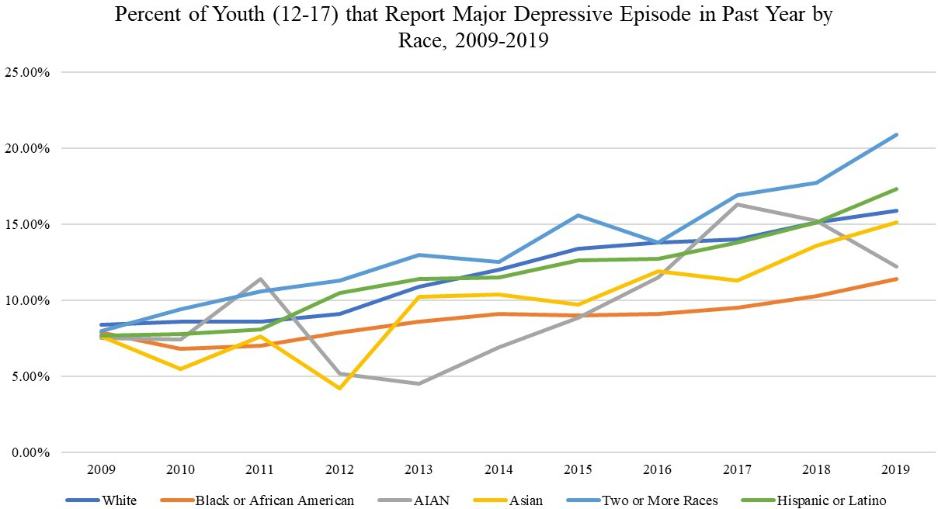
Youth Mental Health Trends are Troubling and Access to Care is Limited
Data Shows Significant Inequity in Outcomes and Access
The percent of youth experiencing depression has doubled in the past decade.
50% of mental health conditions begin before the age of 14 and 75% by age 24. The average delay is 11 years between symptoms and accessing care.
Suicide is the second-leading cause of death for youth, and the suicide death rate for Black youth is rising faster than any other racial/ethnic group.
Only roughly half of white youth and one-third of Black and Latino youth with major depression received treatment.

Slide 4
Mental Health Education
States With Better Mental Health Policies Had Better Mental Health and Substance Use Outcomes
Advocacy Recommendations
Build or improve on existing policy structures whenever possible.
Be vigilant with implementation.

Slide 5
Mental Health Education- New York
Bill Text:
The Difference Two Words Can Make
“§ 804. Health education regarding mental health, alcohol, drugs, tobacco abuse and the prevention and detection of certain cancers.
1. All schools shall ensure that their health education programs recognize the multiple dimensions of health by including mental health and the relation of physical and mental health so as to enhance student understanding, attitudes and behaviors that promote health, well-being and human dignity.
2. All schools shall include, as an integral part of health education, instruction so as to discourage the misuse and abuse of alcohol, tobacco and other drugs and promote attitudes and behavior that enhance health, well-being, and human dignity.”

Slide 6
Mental Health Education- New York
MHANYS’ Resource Center Proposal
“The Resource Center shall help schools identify evidence- based resources to develop mental health curricula, provide resources and guidance to support schools’ ability to comply with the required mental health education of students, make available and accessible mental health training for staff, and provide schools with assistance identifying local mental health services for students in need.”
Appropriations language allocated $1 million in the 2018 budget and $500,000 annually since then.

Slide 7
School Based Services
Medicaid (MI)
Telehealth (TX)
Ratios (CO, VA)
Services at School (KS, MN)
Advocacy Recommendations
Seek sustainable funding for community mental health providers.
Design programs that increase access to mental health care and address inequity.

Slide 8
Excused Absences & Youth Empowerment
Young people care about excused absences for mental health
Oregon HB 2191
Advocacy Recommendations
Empower youth leadership and involvement.
Incorporate ways to hear the voices of all young people

Slide 9
Resources
State Charts
Fact Sheet/Infographic
Playbook
Full Report
Review the charts found in the report to see what exists in your state and what work still needs to be done!
Reach out to state and local agencies and organizations that may already be working in these areas. You can find your local MHA Affiliate here.
Make the case for your desired legislation to local and state policymakers.
Join MHA’s Advocacy Network!

