Slide 1
Emotional PPE Project
Jill Fieleke

Slide 2
Documented Need
Even prior to COVID, healthcare workers (HCWs) were at increased risk for mental illness, addiction, and suicide ^{1, 2}.
COVID-19 impact:
High profile suicides resulted in increasing awareness of need
50% of HCWs surveyed in Italy had signs of PTSD and 25% had signs of severe depression ³.
50% of 1257 doctors & nurses in China had signs of depression ⁴.
Average score of 90 HCPs surveyed in the U.S. was in the clinically depressed range ⁵.

Slide 3
Shechter (2020) Findings

Slide 4
Shechter (2020) Findings

Slide 5
Introducing ePPE
Two neighbors having a conversation.
The need for mental health support for HCW was recognized.
Crowdsourced for mental health professionals willing to offer their time.
Directory was built with intention of removing barriers to emotional support.
Ariel Brown, PhD
Neuroscientist, Mental Health Advocate, Entrepreneur
Daniel Saddawi-Konefka, MD, MBA
Anesthesiology,
Critical Care Physician

Slide 6
Barriers to Getting Help
>80% of HCPs report multiple barriers to seeking supportive services offered by their employer ⁷.
The big three: stigma, time, professional consequences
Stigma: Frequently a dominant aspect of hospital culture; perception that HCW will be seen as weak or that they are unable to do their job well.
Time: Lengthy process of finding a therapist who takes their insurance and has an opening that matches HCW’s schedule, can be prohibitive
Professional consequences: Medical and nursing licensing boards often ask for applicant to release entire history of mental health treatment; may be rejected or have limited licensure based on results.

Slide 7
What is The Emotional PPE Project?
A grassroots nonprofit (501(c)(3)) focused on lifting as many barriers as possible to getting professional emotional support.
A public online directory with contact information of volunteer therapists. No cost and no insurance needed for HCWs.
Addresses time, stigma, and professional consequences.

Slide 8
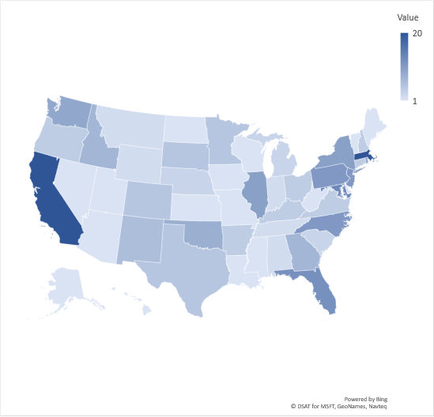
Project Overview
Staffed by 100% unpaid volunteers; funded by individual donations.
As of August 4, 364 mental health practitioners in the directory across all 50 states + DC.
Our therapists have conducted sessions with HCWs across the country.
Users include physicians, nurses, technologists, pharmacists, senior living caregivers.
Currently engaged in awareness building campaign with upcoming story on TODAY show.
Practitioner coverage as of Aug 4
MA set to 20 for visualization purposes

Slide 9
References
Dutheil F., et al., Suicide among physicians and health-care workers: A systematic review and meta-analysis. PloS one, 2019. 14(12): p. e0226361.
Kim M.S., et al., Mental disorders among workers in the healthcare industry: 2014 national health insurance data. Ann of Occup Environ Med, 2018. 30(1): p. 31.
Rossi R., et al., Mental Health Outcomes Among Frontline and Second-Line Health Care Workers During the COVID-19 Pandemic in Italy. medRxiv preprint, 2020.
Lai J., et al., Factors Associated With Mental Health Outcomes Among Health Care Workers Exposed to Coronavirus Disease 2019. JAMA Netw Open, 2020. 3(3): p. 203976.
Pearman A., et al., Mental Health Challenges of U.S. Healthcare Professionals During COVID-19. Front in Psych, 2020. 11: p 2065.
Shechter, A., et al. Psychological Distress, Coping Behaviors, and Preferences for Support among New York Healthcare Workers during the COVID-19 Pandemic. General hospital psychiatry, 2020. 66: p. 1-8.
VITAL Worklife and Cjeka Search, 2017 Physician & Advanced Practitioner Well Being Solutions Survey Report. 2017.

Slide 10
Resilience, Growth, and Traumatic Stress following the COVID-19 Pandemic: Recommendations for Leaders
Jonathan DePierro, PhD

Slide 11
Outline
Psychological impact on workers
Definitions of resilience
Leader actions to support staff
Individual resilience factors
Mount Sinai’s Response in NYC

Slide 12
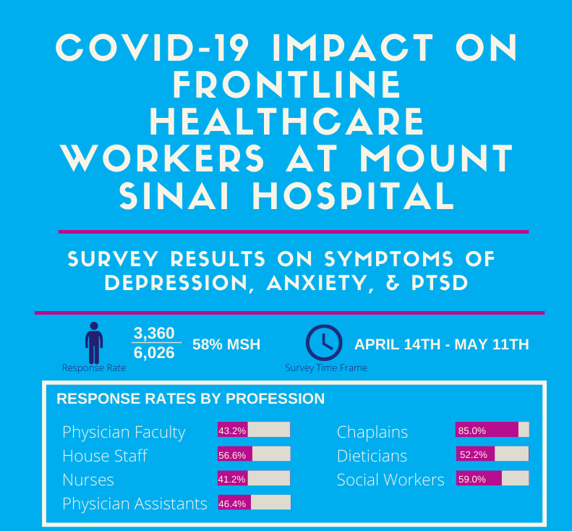
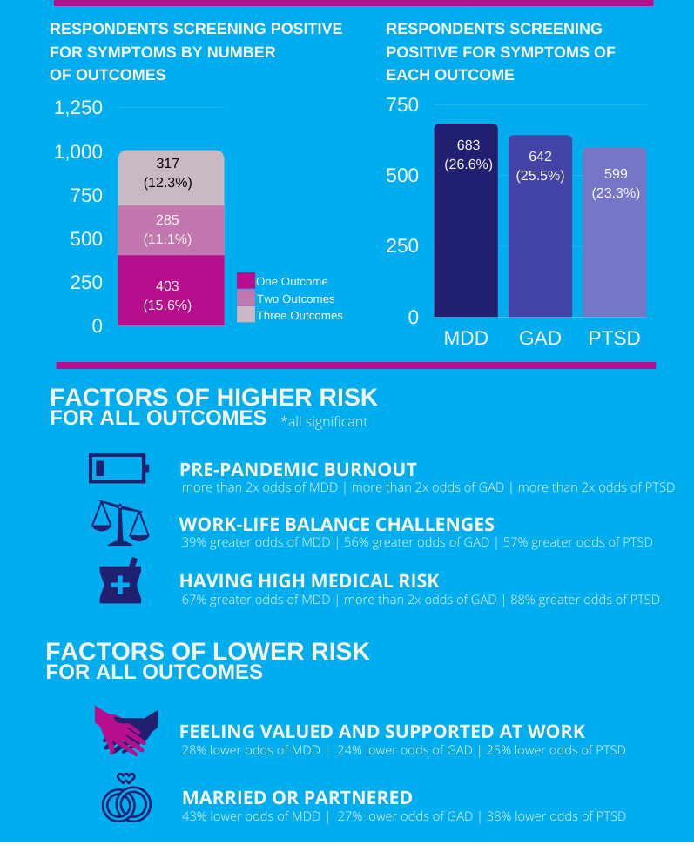
Psychological Impact: Health Care Workers

Slide 13
Significant Psychological Impact: General Public
Rates of distress are also rising in surveys of general public (Pierce et al, 2020)
General population survey in Italy: 37% screen-in for PTS (Rossi et al, 2020)

Slide 14
Workplace Manifestation
Research shows that PTSD and depression are associated with absenteeism & presenteeism (Ferry et al, 2015; Evans-Lacko, 2016)
Now, many workers fear return to in-person work, particularly in hospital setting. Irritability, loss of interest in work, concentration lapses and worsening of burnout may occur – and these reactions make sense given extreme stress.
Secondary stressors pile up (e.g. childcare/school decisions, financial impact, unemployment)
Moral injury may be driving anxiety and depression, particularly in health care workers (DePierro, Lowe, & Katz, 2020)

Slide 15
The Role of Resilience
Resilience is often understood as the ability to “bounce back” after adversity/trauma. Realistic?
Resilience in our view does not mean the absence of distress – sometimes substantial growth can come out of emotional struggle (“posttraumatic growth”).
“Broken but transformed”
Resilience has been defined as a trait, a
process, and an outcome. We know that
it can be cultivated with practice

Slide 16
Context Matters: Resilience Reserve
Leaders must be aware that resilience can be limited by economic and social circumstances, access barriers exist, and some workers are at particularly high risk of persistent distress.
“Hurricane Sandy’s impact was an acute adversity for public housing residents and that their experience was shaped by cumulative social, physical, geographic, economic, and medical vulnerabilities.” (Hernandez, 2018, p. 771)
Diminished “resilience reserve” = “an inventory of potential capacity to confront unanticipated challenges.”

Slide 17
Supporting Resilience

Slide 18
Support From Leadership
Request from staff | Response
Hear me | Listen to and address concerns to the extent possible via multiple feedback channels (email, town halls, individual meetings); shared decision-making
Protect me | Minimize risk by providing adequate PPE, rapid testing, infection prevention strategies, and make accommodations for employees with medical risk factors
Prepare me | Provide access to training and access to experts; clear and unambiguous communication that we are in this together, support is available, everyone is being challenged, and that there are real risks.
Support me | Provide for basic needs, including childcare; provide self-guided support and/or access to individual psychotherapy; centralize support resources navigation. Show gratitude.
Care for me | Provide holistic support if ill; paid time off if quarantine is necessary
Shanafelt, Ripp & Trockel, 2020

Slide 19
Draw on Lessons from Trauma-Informed Care (TIC)
TIC is a model for better serving patients in medical settings who have trauma histories. It includes the following elements:
Screening
Interprofessional Collaboration
Understanding your own history and reactions
Understanding the health effects of trauma
Patient-centered care and communication
Raja et al, 2015

Slide 20
Resilience Factors
Engage in optimism
Face fears
Know and live by your moral compass
Turn to faith/ spirituality
Establish and nurture a social supportive network
Find resilience role models
Attend to physical well-being
Develop brain fitness
Apply cognitive and emotional flexibility to trauma and other challenges
Find meaning and purpose in things
Southwick & Charney, 2018

Slide 21
Mount Sinai’s Staff Mental Health Response
Immediate Response:
Mobilized “mental health liaisons” to support staff, in person and in virtual formats
24/7 crisis support and resource navigation lines
Multisensory recharge rooms
Programs/partnerships to address basic needs (e.g. temporary housing for workers)
Frequent rounding by leadership and Town Halls
Long-term Response
Center for Stress, Resilience and Personal Growth
Centralized resource
Resilience training
Confidential mental health screening
Confidential self-help/self-screening (app)
Treatment & referrals
Partnerships with leaders, unions, stakeholders and administration

Slide 22
Resilience Training Workshops
We have developed a manualized peer co-led resilience workshop series for Mount Sinai workers. These workshops are time-limited and cover 10 evidence-based resilience factors over 11 meetings.
68 peer leaders have been trained
Feedback as been overwhelmingly positive. For example, 86% of co-leader trainees indicated they would change their clinical practice as a result of the training course.
Workshop materials will be made available in a mobile app to maximize our reach.

Slide 23
Thank You!
Center for Stress, Resilience and Personal Growth
https://icahn.mssm.edu/about/departments/psychiatry/clinical/stress-resilience-personal-growth-center
Jonathan DePierro, PhD
Jonathan.depierro@mssm.edu

Slide 24
References
DePierro, J., Lowe, S., & Katz, C. (2020). Lessons learned from 9/11: Mental health perspectives on the COVID-19 pandemic. Psychiatry Research, 113024.
Evans-Lacko, S., & Knapp, M. (2016). Global patterns of workplace productivity for people with depression: absenteeism and presenteeism costs across eight diverse countries. Social psychiatry and psychiatric epidemiology, 51(11), 1525-1537.
Ferry, F. R., Brady, S. E., Bunting, B. P., Murphy, S. D., Bolton, D., & O'Neill, S. M. (2015). The economic burden of PTSD in Northern Ireland. Journal of traumatic stress, 28(3), 191-197.
Hernández, D., Chang, D., Hutchinson, C., Hill, E., Almonte, A., Burns, R., ... & Evans, D. (2018). Public housing on the periphery: vulnerable residents and depleted resilience reserves post-hurricane sandy. Journal of urban health, 95(5), 703-715.
Pierce, M., Hope, H., Ford, T., Hatch, S., Hotopf, M., John, A., ... & Abel, K. M. (2020). Mental health before and during the COVID-19 pandemic: a longitudinal probability sample survey of the UK population. The Lancet Psychiatry.
Raja, S., Hasnain, M., Hoersch, M., Gove-Yin, S., & Rajagopalan, C. (2015). Trauma informed care in medicine. Family & community health, 38(3), 216-226.
Rossi, R., Socci, V., Talevi, D., Mensi, S., Niolu, C., Pacitti, F., ... & Di Lorenzo, G. (2020). COVID-19 pandemic and lockdown measures impact on mental health among the general population in Italy. An N= 18147 web-based survey. medRxiv.
Shanafelt, T., Ripp, J., & Trockel, M. (2020). Understanding and addressing sources of anxiety among health care professionals during the COVID-19 pandemic. Jama, 323(21), 2133-2134.
Southwick, S. M., & Charney, D. S. (2018). Resilience: The science of mastering life's greatest challenges. Cambridge University Press.

Slide 25
Questions
and
Answers
Session

Slide 26
For certificate email:
mhalpern@mhanational.org

