Slide 1
Re-Imagining Psychiatric Care
innovatel.com

Slide 2
Growing Need for Mental Health Services
1 in 5
24%
Over $193 billion in lost earnings per year as a results from serious mental illnesses
Adults in America experience some form of mental illness
of state prisoners have “a recent history of a mental health condition”
50%
13.6 million adults in America live with serious mental illness
of youth (ages 8-15) with a mental illness received no health services in the previous year
Suicide is the 3rd leading cause of death in youth (ages 10-24),
and the 10th leading cause of deaths for adults in the America
60%
of adults with a mental illness received no mental health services in the previous year
The average delay between onset of mental health symptoms and intervention is 8-10 years
Source: National Alliance on Mental Illness (NAMI)

Slide 3
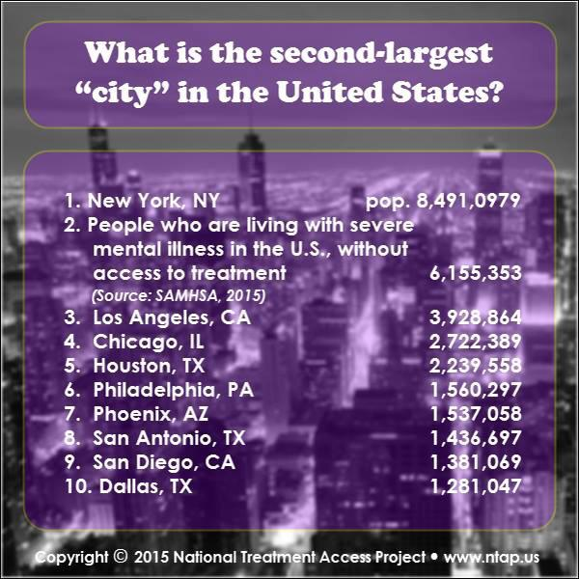
Significant Need for Care

Slide 4
Challenges Facing Clinics
Clinics often struggle with high turn over, particularly with Psychiatrists
Turn over is costly, both financially and clinically. Recruiting is a constant challenge.
Significant challenges with access to care.
At best uneven/inconsistent care for patients.
A wide range in prescribing patterns

Slide 5
Current Industry Trends
Significant increase in demand:
Accountable Care Act
Improved programming enhancing access to care
Systematic downsizing and closing of the long term (State Hospital) level of care
Increase in merger & acquisitions creating large provider organizations
Shortage of qualified clinicians, Psychiatrist, Certified Nurse Practitioners, Licensed Clinical Social Workers
Additional trends:
Challenging pace and complexity of regulatory requirements
Complexity and acuity of patient presentation.
Movement to Integrated care
Improvement in psychopharmacology

Slide 6
Is There Still A Psychiatric Shortage?
The average nationwide distribution of psychiatrists is 8.9 psychiatrists per 100,000**
An average of 1,243 psychiatrists will complete graduate medical education each year from 2014-2017, with 6,032 psychiatrists over the next 4 years***
12,486 active psychiatrists
(59% of total) are 55 and older, placing as the 3rd oldest specialty after pulmonology and oncology**
More than half of the U.S. counties have no mental health professionals*
There is a potential that more psychiatrists will be leaving the specialty per year than entering
Latest data suggests that 40% of all private practicing psychiatrists are accepting cash only

Slide 7
Behavioral Health Workforce Facing Critical Challenges in Meeting Population Needs

Slide 8
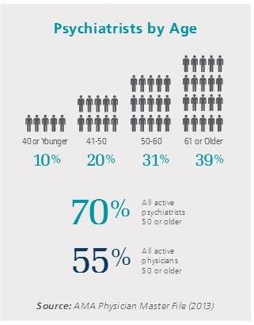
State of the Industry
Greater than 50% of psychiatrists and physicians are over the age of 50.
It is estimated that mental health clinical needs will rise by 5X’s by 2040

Slide 9
Mental Health Specialty Providers Overwhelmed
National average wait time for appointments with a mental health professional is 7.5 weeks
If doctors are accepting new patients, next available appointments may range from 4 to 12 weeks out
In states that have elected to expand Medicaid, providers are experiencing an increased pool of mental health patients due to increased Medicaid enrollment and decreased financial support at the state level for behavioral health services (i.e. closed psychiatric hospitals)
Patients previously cared for at the psychiatric hospital now end up in jail due to limited state funded programing
Shortage of mental health clinicians including psychotherapists, psychologists, and psychiatrists

Slide 10
Physician Recruitment
National trends indicate increasing shortages.
Competitive recruitment: time and expense. Recruitment firms fees average $25,000 to $35,000 per recruit. ($7,500 to $12,000 per CRNP).
Base salary and benefits increasing, average base over $220,000. Benefits include:
Insurances: Health, Dental and Vision coverage, ST & LT disability, Life.
Malpractice insurance.
PTO including CME’s with stipend.
Medical school loan repayment.
Annual licensing and DEA fees in each state.
Workers comp. insurance.
Sign on and retention bonus.

Slide 11
Psychiatric Recruitment Challenges
Retirement of longtime psychiatric staff and nurses
Multiple forms of recruitment failed
Vetting of telepsychiatry firms
Covering clinic responsibilities
Result:
A clear winner!

Slide 12
Positive Changes
Recent legislation waiving state licensing requirements for telepsychiatrists providing care to active duty service members.
Additional legislation proposed to include licensing across State lines for Medicare patients care.
Medicaid covers telepsychiatry in 48 states.
Medicare covers Telepsychiatry based on geographic location.
31 states have legislation requiring private payers to cover telepsychiaty.

Slide 13
Telepsychiatry Overview
Telepsychiatry is being provided in a wide variety of settings – Community Mental Health Centers, Inpatient Hospitals, Residential Treatment, Corrections, Skilled Nursing, etc.
Initially, it is usually implemented as a means of cutting down drive time for direct care providers serving rural locations but other benefits present themselves (i.e. training, supervision, consultation, etc.)
Technology costs have dropped significantly making telepsychiatry service line implementation a no-brainer for administrators and executives
Younger psychiatrists are choosing telepsychiatry as a primary means to practice medicine for reasons like better work life balance

Slide 14
Telepsychiatrist’s Job Satisfaction
Allows the opportunity to fulfill a commitment to provide care to underserved regions (without regard to location) to diverse patients in need of access to care.
The level of collaboration between InnovaTel and Central Kansas Mental Health Center has provided me a level of support assisting me in providing services at the highest level of care.
I have ongoing IT support that allows me to document directly on the electronic record at the clinic, including electronic prescribing.
I have the opportunity to work with a talented, committed staff where I have become a virtual member of the treatment team.
I enjoy having a caseload of patients that I can see consistently in collaboration with the treatment at Central Kansas Mental Health Center.
The ability to partner with Central Kansas Mental Health Center from home provides an opportunity for a very positive work/life balance and overall job satisfaction.

Slide 15
Trending Telepsych
Technology is more readily available and accessible than ever. Direct-to-consumer care is expanding (i.e. Walgreens, MDLive)
More people are insured due to PPACA (Affordable Care Act), increasing demand for clinical services
Telehealth technology is cost effective and quality has improved significantly – fewer barriers to connectivity, better video and audio
Millennials are gaining traction in market demand for expanded access and convenient care, having grown up in the digital age
Payers are more open to technology-based service provision and reimbursement

Slide 16
Operating in a system now driven by payment and delivery system reform
Telepsychiatry: The Innovative Value-Based Strategy
Medicaid Innovation Accelerator Program (IAP)
Patient Protection & Affordable Care Act (PPACA)
Medicare Access and CHIP Reauthorization Act (MACRA)
Behavioral health conditions are nationally recognized as a major contributor to health outcomes and utilization
Comorbidity of behavioral health has a direct impact to overall health care costs
Telepsychiatry may be the key element you are missing to support your comprehensive integrated care service delivery model

Slide 17
Thank You!
Jonathan Evans
President and CEO
innovaTel Telepsychiatry
Jon.evans@intelpsych.com
866.492.7597

