Slide 2
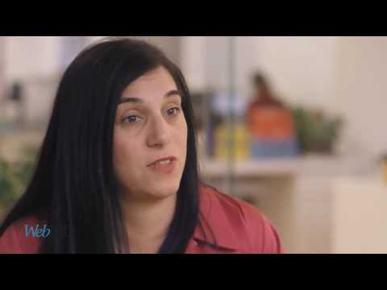

Slide 3
How it Works

Slide 4
Crisis Text Line provides free, 24/7 support for people in crisis via text.
Notes:
Crisis Text Line is 24/7 support at your fingertips! Text is private, accessible and easy-to-use. It’s the medium that people know and trust.
No likes, ums, hyperventilating or crying, which for Crisis Counselors helps us understand what’s going on, and for texters the act of typing things out can be theraputic
Private: your mom won’t hear you through the wall
Asyncronous: we see a spike every day during lunch time because people text us from school.

Slide 5
741741
Notes:
It’s right up the left side of your keypad.
It’s completely free, and the number is removed from phone billing statements

Slide 6
Why Text?
Private, comfortable, accessible
Time of Day
⅔ of conversations in ⅓ of the day (8pm - 4am)
Demographic
80% of texters are under 25 years old, over-index on serving rural populations
Texting in Crisis
Notes:
30% of conversations are around suicide and depression, BUT we are not purely a suicide hotline. People text about all sorts of things and a crisis to you = a crisis to us
Young: 75% of texters are under 25 years old
Low Income: 19% of our text volume is from the 10% lowest income area codes across the US. We over-index on serving low income populations.

Slide 7
Who are
Crisis Counselors?
Mothers
Veterans
College Students
Grandfathers
Grandmothers
Survivors
Deaf/Hard of Hearing
Fathers
Notes:
Trained, background checks, 34 hour training
We have such a positive, incredibly diverse community of 3500+ Crisis Counselors (and growing)! They range from 18-78 years old.

Slide 8
Rigorous Application
Only ⅓ of people who apply become Crisis Counselors
34-Hour Training
Video modules, quizzes, live roleplay, live observation
Active & reflective listening, suicidal risk assessment, collaborative problem solving
Training Advisors
Reviewed by American Foundation for Suicide Prevention, National Domestic Violence Hotline, RAINN, NEDA
Counselor Training

Slide 9
Ladder-Up Risk Assessment: A Visual Aid
If a texter answers “yes” to all four of the ladder-up risk assessment questions, the texter is considered to be at imminent risk. Supervisor will be flagged and take active role in conversation.
Imminent Timeframe
It’s brave of you to share that. Do you have a time planned for when you would do [x]?
Access to Means
It sounds like you’ve thought about this. Do you have the [x] you would need to do [x]?
Has a Plan
Thank you for your honesty. Do you have a plan for how you would do it?
Suicidal
Thoughts
When you say you want to disappear, do you mean you’re thinking of suicide?

Slide 10
Why Volunteer?
“Because practicing empathy and reflective listening makes me a better friend, partner and employee.”
“It teaches me about believing in hope, trusting the process, and deepening compassion -- for others and for myself.”
Notes:
Why do YOU volunteer? Share your story!

Slide 11
HOW IT WORKS
Texter
Crisis Counselor
Notes:
A person texts 741741 when they’re in crisis
Crisis Counselor responds -- but we’re actually on our computers! You take shifts from your laptop, from your own home!

Slide 12
Crisis Counselors
Are Never Alone
Algorithm
Supervisor
Peers

Slide 13
Our queue of texters is stack-ranked based on severity.
Algorithm recognizes high-risk words and phrases
High-risk texters matched with a Crisis Counselor in average of 52 seconds
Algorithm
Notes:
Algorithm: our system stack ranks based on severity. It recognizes phrases most often associated with active rescues -- things like “Help me now” or “I want to die” and pushes them to the top of the queue. These high risk texters are matched with Crisis Counselors in an average of 1.8 minutes (and our goal is to get to every texter in under 5 minutes)

Slide 14
Supervisors are full-time staff with higher degrees in social work, psychology, or counseling
Oversee volunteer Crisis Counselors with a live view of all conversations
Supervisors will call emergency services when necessarily (on average, 10 times per day across nation)
Supervisor
Notes:
Supervisors: full-time staff with Crisis Text Line, have masters or pHDs in Counseling, Social Work or Psychology. They oversee Crisis Counselors and call emergency services when necessary.

Slide 15
Searchable database in platform of vetted and approved websites, categorized by issue type
Resources for Texters

Slide 16
Confidentiality
Texting fee and bill record waived from four major phone carriers.
Active Rescues
Emergency services called when texter is an imminent danger to themselves or others (average 13x per day across nation)
Mandatory Reporting
Request personally identifiable info when we suspect child abuse or neglect. Report is filed according to guidelines of state the texter is in.
Safeguards for Texters

Slide 17
Limited Liability
We follow typical liability protocols -- similar to phone hotlines -- that limit liability for Crisis Counselors and Supervisors
Monitoring Quality
Supervisors have live view of all conversations; quality metric tracked
More Details
Check out crisistextline.org/privacy
Safeguards for Counselors

Slide 18
Data & Partnerships

Slide 19
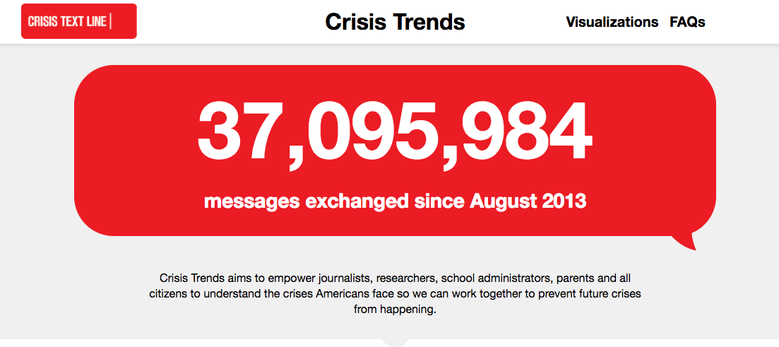
We Use Data to Make The World Better
We aggregate and analyze crisis trends data
Worst day of the week for suicidal ideation? Sundays
Worst time of day for substance abuse convos? 6am
Visit crisistrends.org to explore more
CrisisTrends.org
Notes:
Natalie

Slide 20
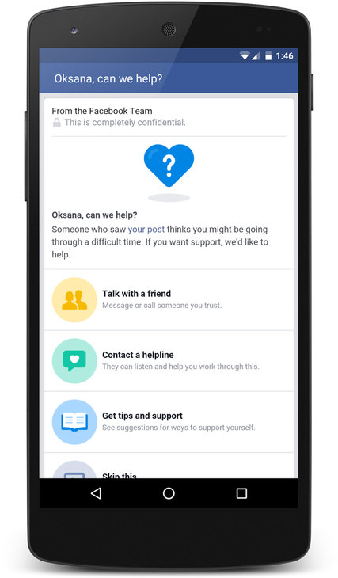
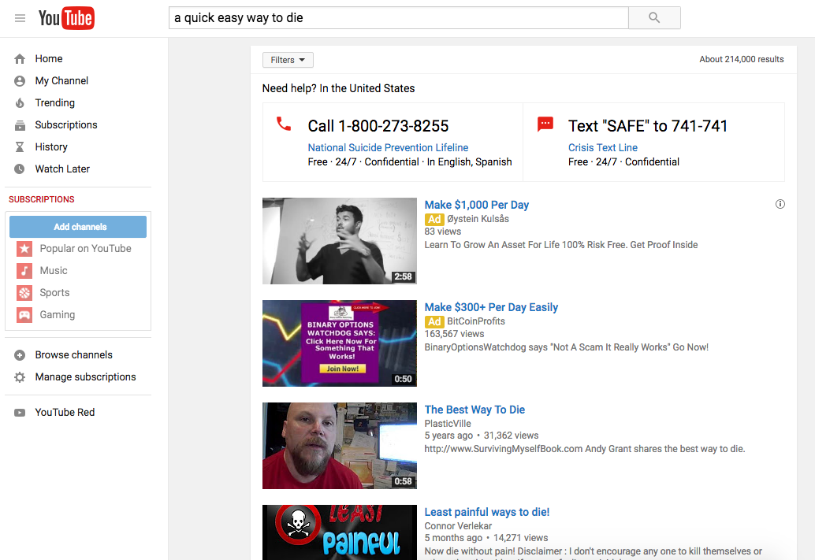
Corporate Partnerships
Notes:
Another exciting part of our work is the partnerships we’ve developed with companies like YouTube, Facebook and Instagram, to make sure that they’re users who are in crisis can quickly and easily get connected to a Crisis Counselor.
YouTube: when you search suicide or other high risk words on YouTube, our number is the first thing that appears so that YouTube users in crisis know our resource is out there for them
On Facebook and Instagram, you can flag a friend’s post that looks suicidal. That friend will see a message that someone is worried about them, with options of what they can do. One of those options is messaging a Crisis Counselor, and they can do that within Facebook Messenger

Slide 21
Presidential Election
4x our normal volume
Most common association with “scared” was LGBTQ issues
5% mentioned anxiety about family disagreements
2.2% mentioned immigration
Notes:
Weekly newsletter about interesting data, updates, shout outs to CCs who have leveled up or hit one year!
Supervisor Tips: features a different awesome Supervisor each week and helps you on the platform
Crisis Counselor Perks: we love showing love to you! Free six flags tickets, discounts to Warby Parker, coloring books...and more!
Swag Store: amazing Swag Store exclusively for us with lots of Crisis Text Line swag (socks, mugs, and fuzzy blankets!)
Crisis Counselor Advocates: staff members whose job is to support YOU. Cheer you on, debrief with you, and always be there.

Slide 22
Partners
Notes:
Some nonprofit and city partners we work with.
Golden Gate Bridge has our number on 30 signs on the bridge and in the parking lots
Caltrain has our number in stations and on trains

Slide 23
Thank You!
In crisis? Text MHA to 741741
Volunteer: crisistextline.org/volunteer

