Slide 1
The power of wellness
Pamela Jones & ana contreras

Slide 2
objectives
Identify the main neurochemicals and hormones that are key to physical and mental health.
Articulate the seven components of the wellness wheel as a tool in recovery.
Utilize the wellness wheel as a strategy for engaging members in recovery.
Utilize the wellness wheel as a team-building tool.

Slide 3
MHA-Antelope valley core values
Core value (Hope): ….consistent practices that inspire members, staff and the community, to believe in their dreams… and that everyone is worthy of living a happy, productive and meaningful life.
(Spiritual, Emotional and Social component)
Core value (innovation): A new way of doing something…[that changes] the value of services. The goal of innovation is a positive change, to make someone or something better [by] promoting knowledge, networking and independence for individuals.
(Intellectual and environmental Component)
Notes:
Psychiatric rehabilitation- is the process of restoration of community functioning and well-being of an individual diagnosed in mental health, whether its mental or emotional disorders and who may be considered to have a psychiatric disability.

Slide 4
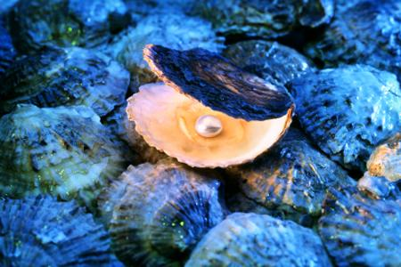
The royal pearls of fitness
“redefined by the oceans waves,
I now become the pearl.”

Slide 5
Does anyone know the difference between health and wellness?

Slide 6
Health Vs. wellness
Health
Health refers simply to a physical body being free from diseases.
Wellness
wellness is an overall balance of your physical, social, spiritual, emotional, intellectual, environmental, and occupational well-being.
~University of Utah
~The adaptation Model of Nursing
Notes:
Reference
Premier Rapport. 2015. Be well and stay connected. Retrieved on November 6, 2016 from http://premierrapport.com/what-is-the-difference-between-health-and-wellness/
http://wellness.utah.edu/wellness-wheel.php)

Slide 7
Diet
Eat the first meal of the day
Proper portion size
Vary your meals
Don’t skip meals
https://www.facebook.com/BeConstantlyCurious/videos/124743974858320
“an ounce of prevention is worth a pound of cure.”
-Benjamin Franklin
Notes:
https://www.facebook.com/BeConstantlyCurious/videos/124743974858320

Slide 8
Exercise
Stretch first
Ride your bike
Head to the gym
Walk to places
Bring a friend
“if I have believe that I can do it, I shall surely acquire the capacity to do.”
- Mahatma Gandhi

Slide 9
sleep
Don’t work in bed
Stick to a schedule
Avoid caffeine, eating, and drinking right before bed.
“with the new day comes new strength and new thoughts.” –Eleanor Roosevelt

Slide 10
The happiness effect

Slide 11
neurochemicals and hormones

Slide 12
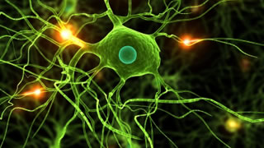
The happiness effect
BDNF
GABA
Endocannabinoids
Neurotropic factor that protects the brain from emotional disorders and repairs damage form stress and depression.
Calming neurotransmitter that builds immunity to stress.
Closely related to the cannabis plant.
Natural chemical compounds that play a role in processing appetite, pain sensation, mood, and memory.

Slide 13
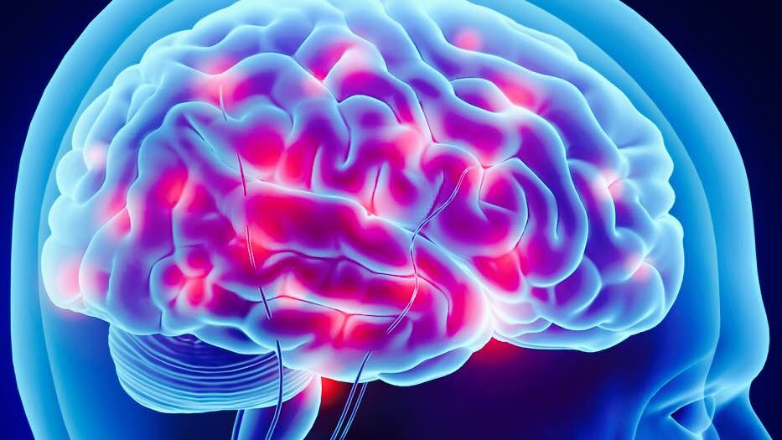
The happiness effect
endorphins
Norepinephrine
Antibodies
Pain fighting peptides that increase within the first 20 minutes of exercise that are the building blocks of protein.
(no-re-pen-eferin)
Is a stress hormone. this neurotransmitter is responsible for the fight-or-flight response when there is too much stress in your body.
Are special proteins produced by the immune system that help fight viruses.
Exercise and happiness increases the antibody production.

Slide 14
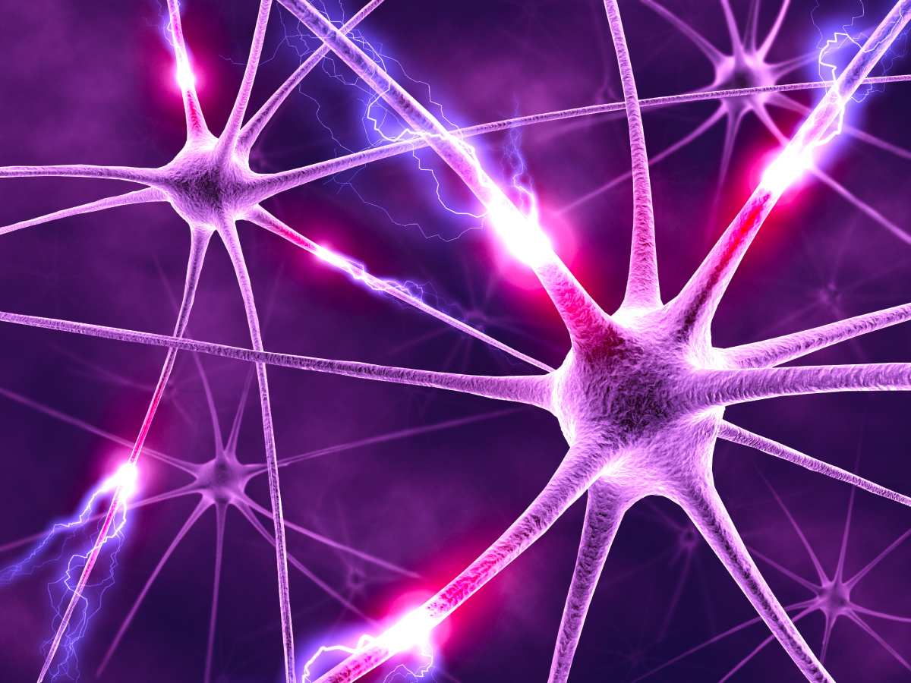
The happiness effect
dopamine
serotonin
Neurotransmitter that is a “feel good” mood boosting chemical.
Responsible for relaxation, euphoria feelings, pleasure.
Neurotransmitter that is responsible for feelings of serenity and hopefulness.
Low levels are linked to depression.
Antidepressants increase these levels and so does exercise.

Slide 15
Wellness wheels
Provider
staff
member
Notes:
Reference
University of Utach. Center for student wellness
http://wellness.utah.edu/wellness-wheel.php

Slide 16
Emotional
Based on how you feel.
Notes:
Ingrid Story and going to school as an outcome

Slide 17
intellectual
Is the ability to be open to new experiences and ideas to continue to grow.
Notes:
Discuss cooking class for TAY, teach families about healthy food choices, art festival for entire agency, homeless cart.

Slide 18
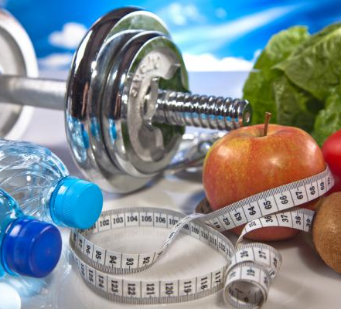
physical
Maintaining a healthy body through exercise and nutrition.
Notes:
Fabian story about gym and horse therapy (Equine Therapy)

Slide 19
social
Involves participation in your community.
Notes:
Community Participation- Community Fair Competition, ribbon, flyer, newsletter

Slide 20
Environmental
Taking care of your global environment and your personal surroundings.
The Adaptation Model of Nursing was developed by Sister Callista Roy in 1976
Notes:
Gregory story about recycling cans to pay phone bill.
Member taught us and peers a new life skill for recovery.
Office decorations.

Slide 21
financial
The ability to establish balance between work and fun time.
Able to make choices that allow you to enjoy life.
Notes:
Bring in homeless housing.
Shop at 99 cent store.

Slide 22
spiritual
The ability to discover meaning and purpose in life.
Helps to establish peace and harmony in our lives
Notes:
https://www.youtube.com/watch?v=NZ1o3mBbhws&sns=em

Slide 23
Story telling Wellness wheel
Notes:
2 people from audience to spin the wheel and share a story
Reference:
University of Utach. Center for student wellness
http://wellness.utah.edu/wellness-wheel.php

Slide 24
Contact information
Pamela jones
pjones@mhala.org
Ana Contreras
acontreras@mhala.org

Slide 25
Quote of the Day
“today you are you, that is truer than true. There is no one alive who is youer than you.”
~Dr.seuss

